Slide 1

Apache Beehive
Dima Ionut Daniel

Slide 2
Contents
What is Beehive?
History
Architecture
Components
Page Flow
NetUI Components
Controls
Web Services
Bibliography

Slide 3

What is Beehive?
Apache Beehive is a java web framework.
It was developed by BEA Weblogic 8.1 and later they decided to donate the code to Apache.
The Apache Beehive was created to support the Java Page Flow technology, Controls and Web Services based on JSR 181.

Slide 4
History
BEA Weblogic 8.1 created the framework in order to develop Java EE applications more quickly.
BEA decided to open-source the project under the Apache Software Foundation license.
latest version of Beehive was released in 4 December 2006.
It's lifetime ended in January 2010 when it has been retired and moved to Apache Attic.

Slide 5
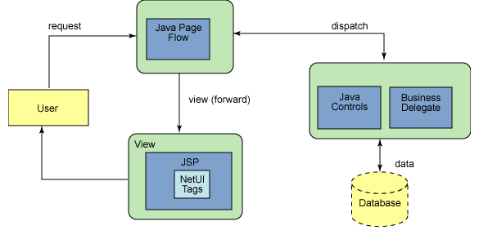
Architecture
All Apache Beehive components fit into MVC(Model-View-Controller) programming model.
JPF(Java Page Flow) it's the controller layer.
The NetUI tag libraries are part of view layer.
The model layer is built from Java controls.

Slide 6
Components
Netui Page Flows
application framework built on top of Apache Struts which allows easier tooling and automatic updating of the various Struts configuration files.
Controls
This is the heart ot Beehive framework.
A control can access enterprise-level resources such as EJB, WebService, etc.
Webservices
Enables the creation of webservices using meta-data/annotations quickly.
Using this approach any plain java class can be converted into a web service.

Slide 7
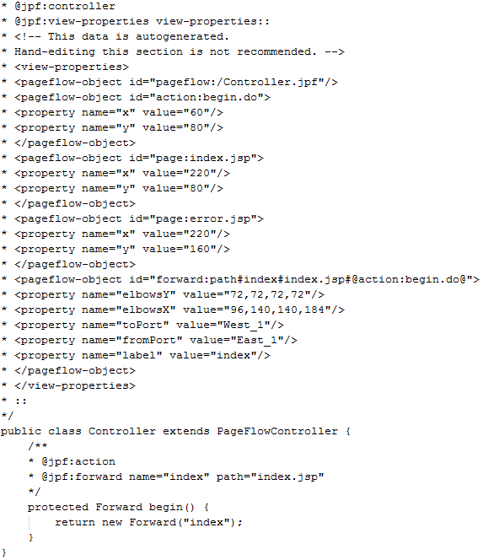
Page Flow
The controller code is a Java source code file with the extension .jpf to denote that it’s a Java Page Flow.

Slide 8
NetUI Components
NetUI is a set of tag libraries that are JSP 2.0 compliant.
There are 3 tag libraries:
NetUI
NetUI-data
NetUI-template

Slide 9
NetUI Components (cont.)
Common components:
<netui:base> → provides base for every URL on the page
<netui:bindingUpdateErrors> → renders set of error message found during processing
<netui:body> → render HTML <body> tag with attributes specified
<netui:button> → renders HTML button with specified attributes
<netui:content> → displays text or result of expression
<netui:error> → renders error message
<netui:exceptions> → renders exception messages and stack traces inline on JSP
<netui:form> → renders HTML form that can be submitted to a Java method

Slide 10
NetUI Components (cont.)
Common components:
<netui:formatDate> --> renders a formatter used to format dates
<netui:formatNumber> --> renders a formatter used to format numbers
<netui:formatString> --> renders a formatter used to format strings
<netui:html> --> renders <html> tag
<netui:hidden> --> generates a HTML hidden tag with a given value
<netui:image> --> renders a HTML <image> tag with attributes
<netuit:label> --> associates text with input element in a form

Slide 11
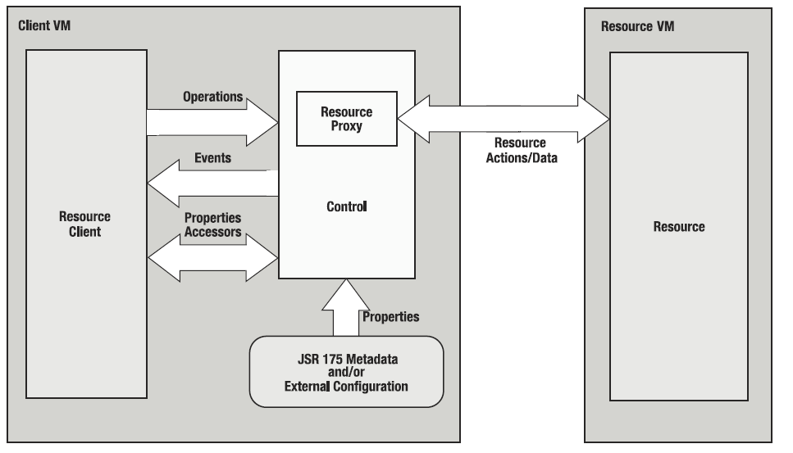
Controls
A Control is a java object that encapsulates business logic or controls access to resources.

Slide 12
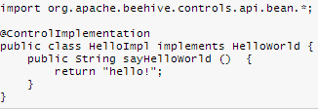

Controls (cont.)
A control provides a layer of abstraction.
Controls are used as wrapping up EJB or message-driven beans.
They provide a common client interface to any set of resources: databases, external systems, etc.

Slide 13
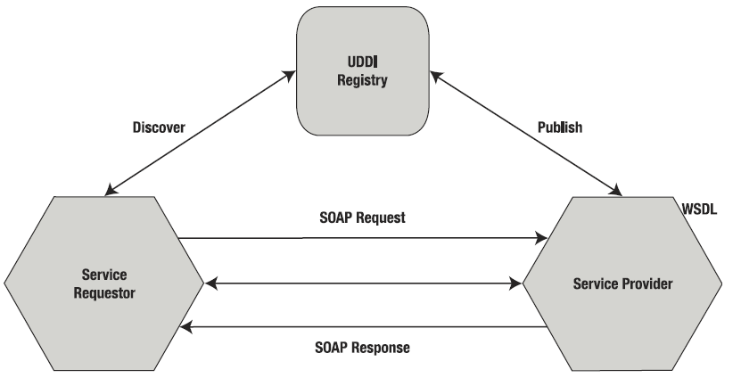
Web Services
Web Services are a set of specifications built on top of open, cross-platform standards such as TCP/IP, HTML, XML.
A Web Service consists of a service provider that is defined in the Web Services Description Language (WSDL)
and published using UDDI(Universal Description, Discovery and Integration0 called a registry.
A service requestor(Web Service client) discovers the Web Service in the UDDI registry.

Slide 14
Web Services (cont.)
Miscellaneous web service standards:
SOAP 1.2 Attachment Feature
Web Services Addressing
Web Services Reliable Messaging
Web Services Policy Framework and Web Services Policy Attachment
Web Services Coordination
Web Services Transaction
Web Services Security
Web Service Choreography Interface

Slide 15
Web Services (cont.)
Using annotations in JSR 181, we can easily expose any Java class as a Web Service:
@WebService: class is exposed as WebService.
@WebMethod: method will epose a ws operation.
@WebParam: specifies parameter exposed in the WebService.
@WebResult: maps return value to a WSDL element.
@OneWay: specifies that method has only input message and no return value.
@InitParam: specifies any initialization parameters for the WebService.
@SOAPBinding: binds WebService to SOAP.

Slide 16
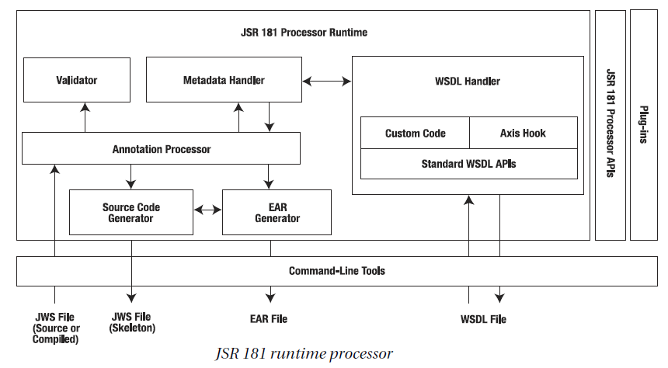
Web Services (cont.)

Slide 17

Bibliography
http://en.wikipedia.org/wiki/Apache_Beehive
http://www.ibm.com/developerworks/library/os-beehive/
Apress - Pro Apache Beehive

